Slide 1
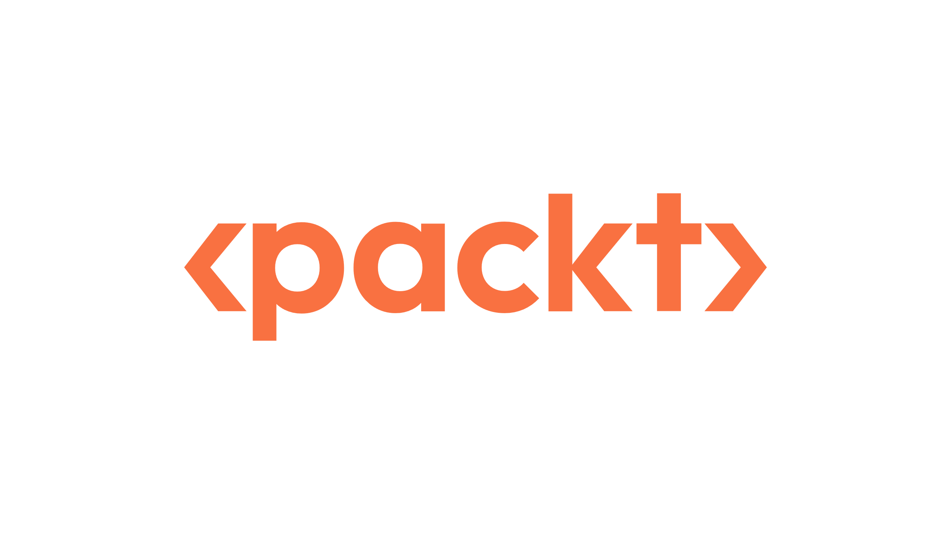

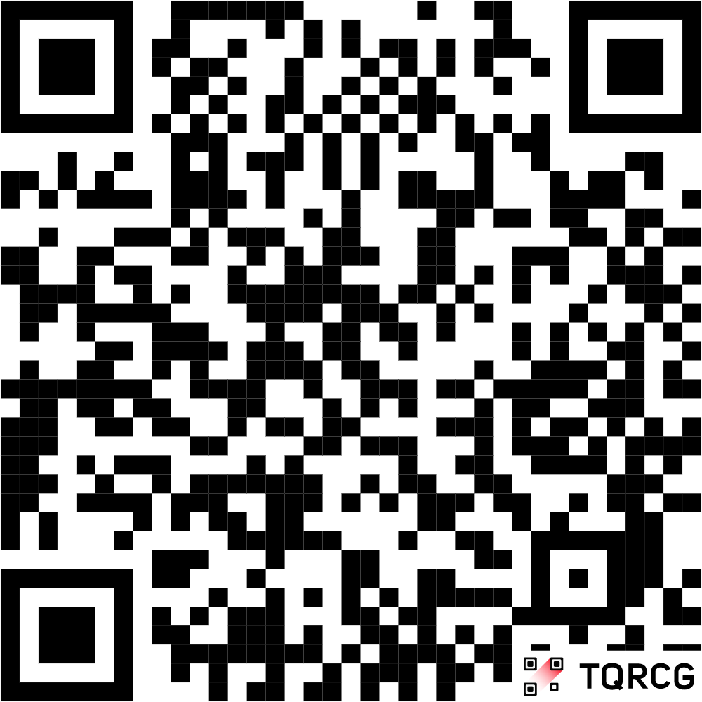


Starting Now
INSIDE THE OPEN-SOURCE SNOWFLAKE AI TOOLKIT
Shankar Narayanan SGS
Principal Architect
Microsoft
Snowflake Data Superhero

Slide 2
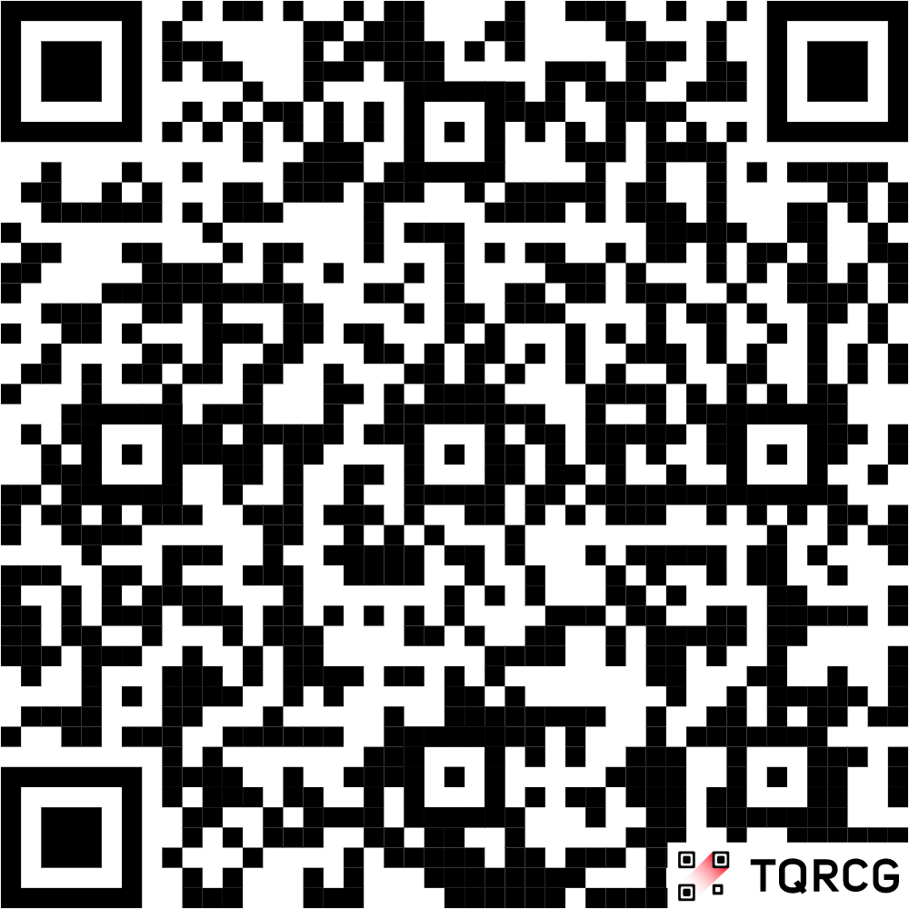

Starting Now
INSIDE THE OPEN-SOURCE SNOWFLAKE AI TOOLKIT
Vivekanandan SS
Senior Manager - GenAI Enablement
Verizon
Snowflake Data Superhero

Slide 3
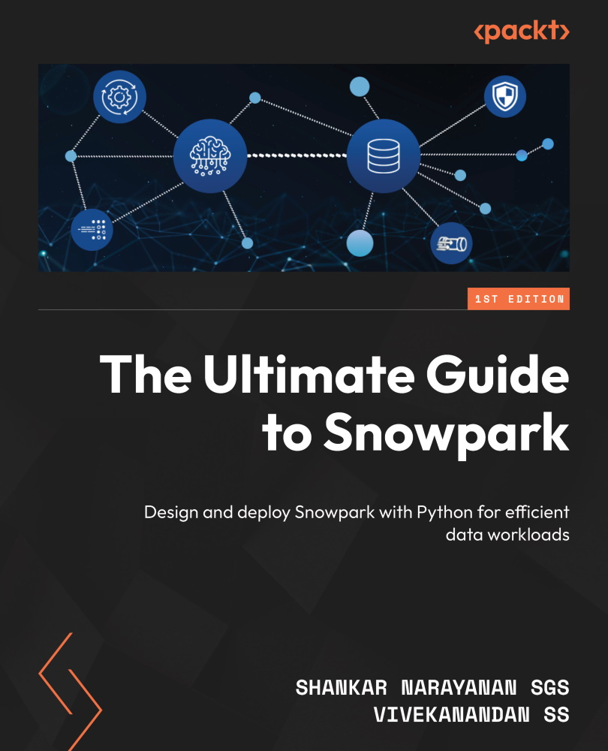
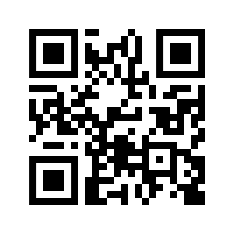
Snowpark Book
Harness Snowpark with Python for diverse workloads
Deploy mature machine learning models
Deploy and operate Containers in Snowpark
Explore the process of developing, deploying, and monetizing native apps using Snowpark
Develop robust data pipelines with Snowpark using Python
Discover the pathway to adopting Snowpark effectively in production
>
Pg: 3
Notes:
Q. Is this the first time you are hearing about the Book?
Option 1 - Yes
Option 2 - No
Q. Have you read the Snowpark Book?
Option 1 - Yes
Option 2 - No

Slide 4

INSIDE THE OPEN SOURCE SNOWFLAKE AI TOOLKIT
AI Innovation in the AI Data Cloud
Notes:
Q. Do you currently use or plan to use Snowflake?
Option 1 - Yes
Option 2 - No

Slide 5
Agenda
01
Challenges in Adopting AI
02
Why Snowflake AI Toolkit
03
Toolkit in Action
04
Roadmap

Slide 6
Challenges in Adopting AI

Slide 7
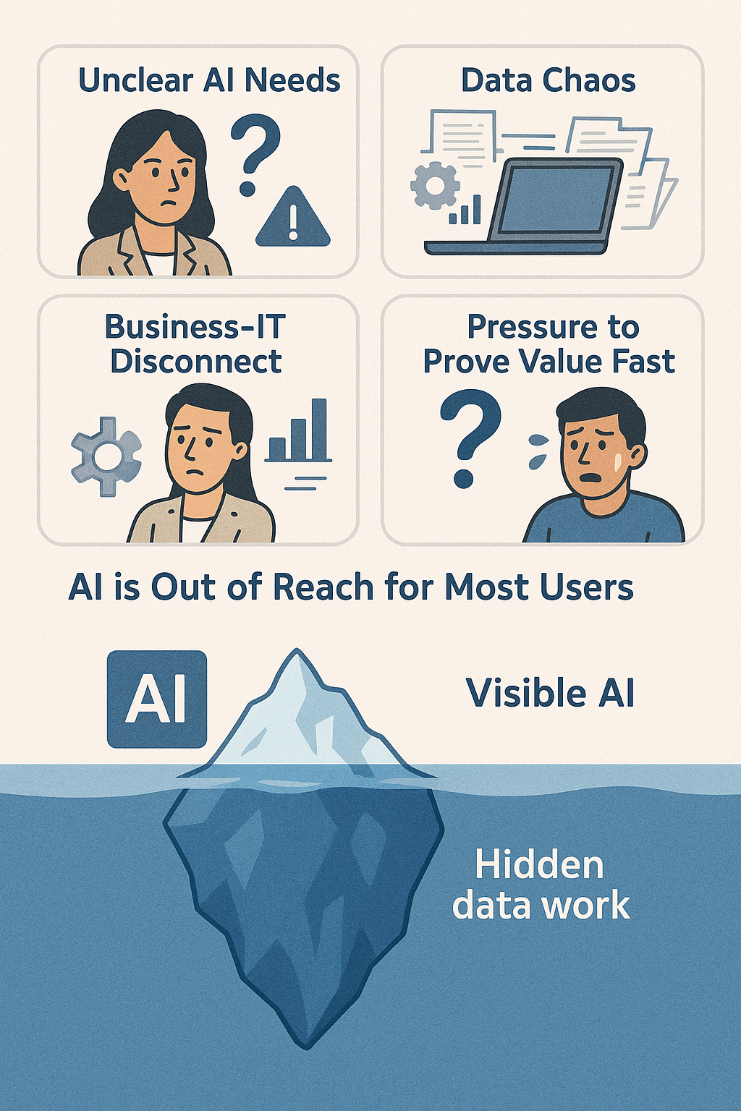
Challenges in Adopting AI
Unclear AI Needs
Data Chaos
Business-IT Disconnect
Pressure to Prove Value Fast
AI is Out of Reach for Most Users
>
Pg: 7
Notes:
Q. Do you currently adopt AI in your organization?
Option 1 - Yes
Option 2 - No

Slide 8
Why Snowflake AI Toolkit

Slide 9
Snowflake AI Toolkit
AI Accelerator and Playground
Plug and Play Streamlit based App
Playground, Build, Search and Agent Features
Powered by Snowflake Cortex AI and other AI Functions
Open-Source License
Works as Native App or Local mode
>
Pg: 9

Slide 10
Why Snowflake AI Toolkit
From AI Buzz to Business Impact
Built on Trusted Data Foundations
Bridging Business and IT with Usable AI
Accelerated Proof-of-Value (POV)
AI for Everyone, Not Just Data Scientists
Free Time / Difficulty to Fall Asleep
>
Pg: 10

Slide 11
What you can do with this
Test and quickly explore Cortex AI’s native features.
Rapidly prototype and build AI-driven solutions.
Execute AI use-cases like RAG and fine-tuning with custom datasets.
Customize and extend the toolkit to fit any specific use case or organizational need.
Shorten development time with pre-built functions.
Learn and practice Snowflake AI features.
>
Pg: 1 1

Slide 12
Use Cases Covered
🔍 Explore Snowflake's multimodal and conversational AI – using our no-code toolkit
💬 Build chatbots over your Snowflake tables in minutes – turn your data into a conversation
🎯 Bring your own data (BYOD) for smarter responses – customize your LLM with no dev effort
>
Pg: 12

Slide 13
Toolkit in Action
Notes:
Q. Do you currently use Snowpark or Cortex?
Option 1 - Yes
Option 2 - No

Slide 14
Roadmap

Slide 15
Roadmap
Integration of TrueLens
Integration of Agentic Interfaces
Function to Connect to MCP (Model Context Protocol)
APIs for Apps in Container Services
Common Demos by Industry
>
Pg: 15

Slide 16
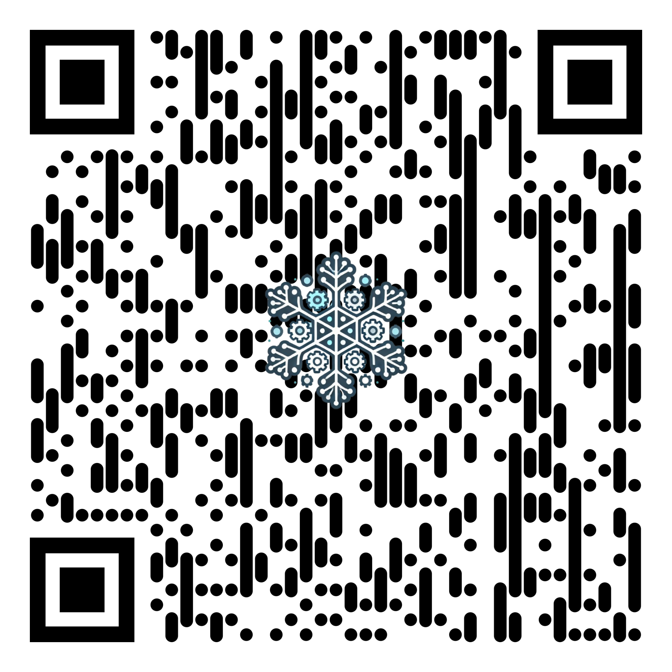
Snowflake AI Toolkit
https://github.com/Snowflake-Labs/Snowflake-AI-Toolkit
>
Pg: 16

Slide 17
Thank You

